Slide 1
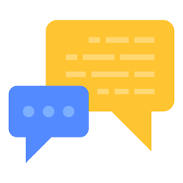
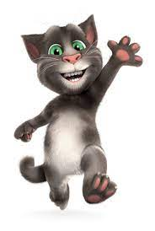
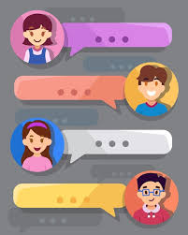
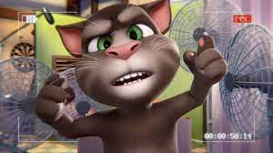
AI Chatbot

Slide 2
Introduction
This chatbot is created to simulate talking with a companion, motivated from our old pal, Talking Tom.
More and more people are using chatbots like Replika, which launched in 2017 & has over 10 million active users
Chatbots seamlessly transfer conversations from bot to human and back.
A chatbot can answer simple questions or link to any article.

Slide 3
Our goal
We aim to have a chatbot that can have a basic conversation without getting off track or say something random.
Majority of chatbots are used for business, but ours is primarily used for personal conversations similar to Better Help, just more laid back.

Slide 4
Libraries/Model
We are using tensorflow, nltk, numpy, pickle and tflearn.
And our dataset is intents.json. Our model is tflearn and DNN(Deep Neural Network). For testing and validation we have created chat function.

